Slide 1
3PR3 final project
Tax software

Slide 2
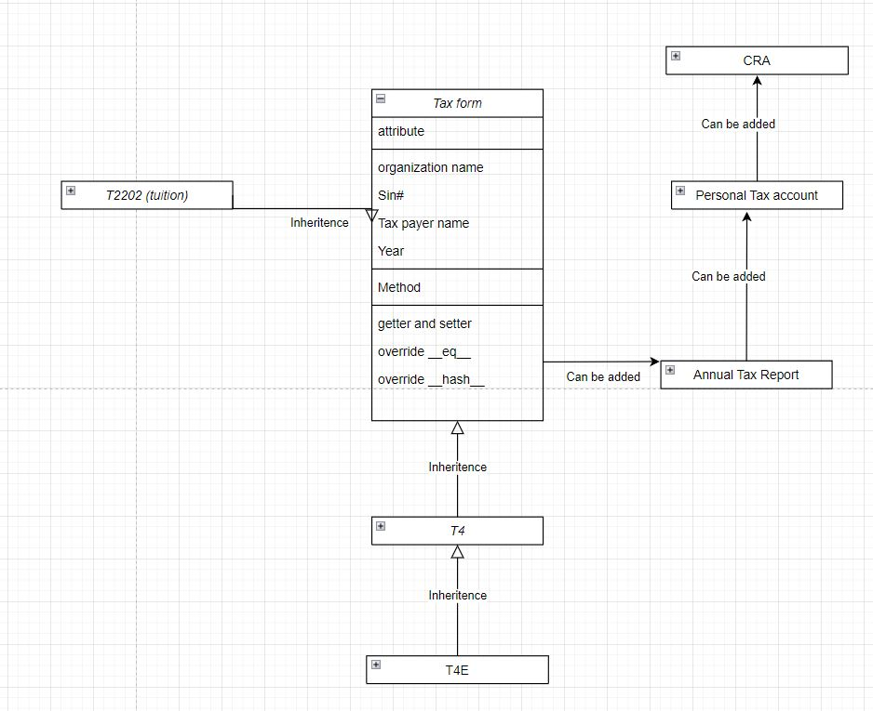
Overall Structure

Slide 3
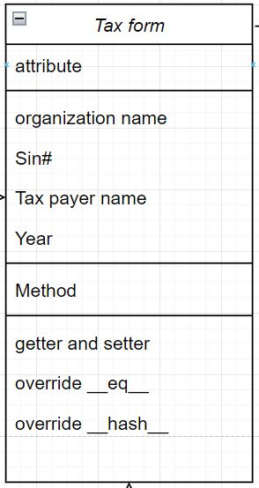
Base class: Tax form

Slide 4
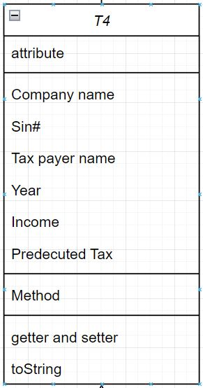
Class: T4 (inheritance from Tax form)

Slide 5
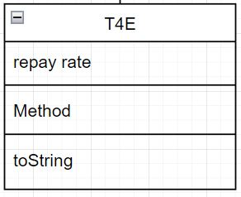
Class:T4E (inheritance from T4)

Slide 6
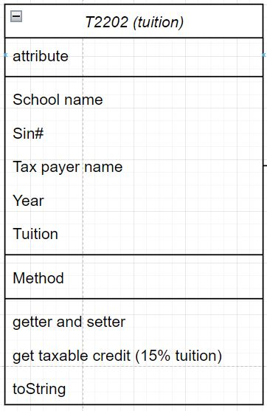
Class:T2202 (inheritance from Tax form)

Slide 7
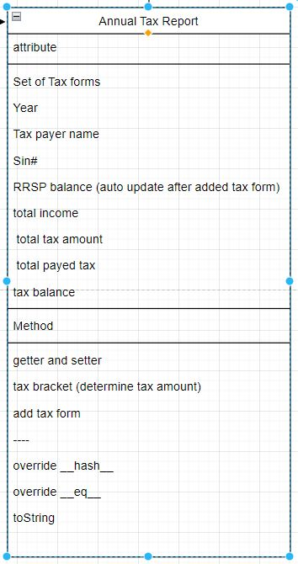
Class: Annual tax report

Slide 8
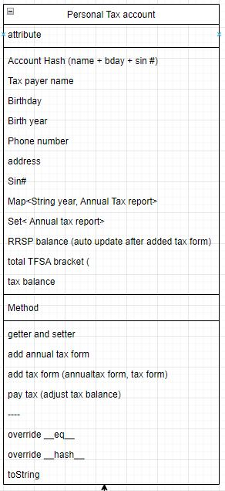
Class: Personal tax account

Slide 9
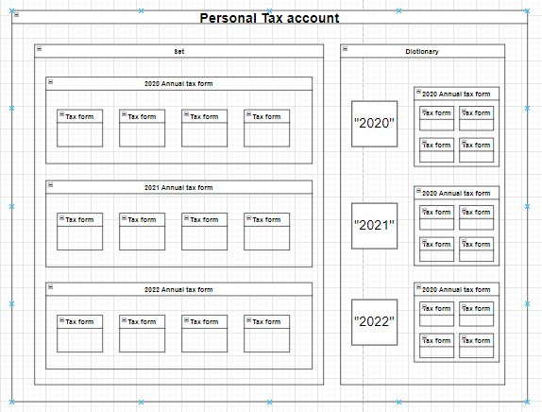

Data structure

Slide 10
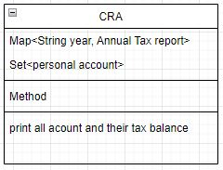
Instance of Class CRA

